Slide 1
Senate Finance Committee Wednesday, February 8, 2017
ERB Update
Jan Goodwin, Executive Director
Mary Lou Cameron, Board Chair
H. Russell Goff, Board Vice Chair

Slide 2
Pressing Issues
Brief update on agency
Challenging investment environment
Ability to hire and retain qualified investment professionals
Long-term sustainability
State fiscal situation

Slide 3
Brief update: ERB Highlights as of June 30, 2016
Active ERB Members | 60,057
Retirees and Beneficiaries | 45,797
Retiree Payroll | $973,703,652
Member Contributions | $295,946,396
Employer Contributions | $396,988,557
Member Contribution Refunds | $39,027,078
Active Member Payroll | $2,612,044,476
Participating Employers | 218
ERB Net Assets | $11.5 billion
Average Benefit | $21,972
Average Age at Retirement | 61.51

Slide 4
ERB’s December 31, 2016 Investment Performance, net of fees

Slide 5
Total Fund Asset Growth Summary as of December 31, 2016

Slide 6
Challenging Investment Environment
Low return environment
Mitigating factors:
Asset diversification
Cost efficient investment strategies

Slide 7
ERB’s Changing Asset Allocation

Slide 8
Ability to Hire and Retain Investment Staff
Continued strong investment performance requires appropriate staffing
Our salaries are no longer competitive
SB 29 will give more flexibility for investment staff salaries
EnnisKnupp Priority Recommendation #19: “Seek staffing autonomy to allow the ERB to fill all investment positions without being bound by state personnel office procurement practices.”

Slide 9
Long-term Sustainability
Trends are going in the right direction
Requires continued diligence by Board Experience studies every two years

Slide 10
ERB Actuarials at a Glance
Fiscal Year | 6/30/14 | 6/30/15 | 6/30/16
UAAL | $6.3B | $6.5B | $6.6B
Funded Ratio | 63.1% | 63.7% | 64.2%
Funding Period | 42.1 years | 43.2 years | 44.9 years

Slide 11
State’s fiscal situation
State fiscal situation threatens education budgets
Fewer employees/shorter school year reduces contributions

Slide 12
ERB Schedule of Contribution Rates

Slide 13
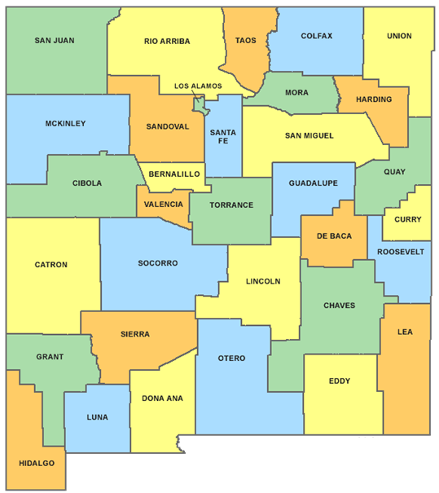
Fiscal Year 2016 Retiree Benefits by County
$37,787.6
$20,623.6
$14,103.4
$5,728.7
$2,136.1
$6,471.4
$3,714.0
$682.7
$16,311.4
$43,406.9
$21,045.7
$44,918.3
$301,397.5
$3,738.3
$6,070.1
$2,531.4
$28,150.7
$4,625.4
$17,579.6
$987.0
$1,318.6
$13,628.0
$12,002.8
$9,480.9
$25,351.4
$4,007.6
$16,208.3
$16,839.3
$18,637.4
$22,789.5
$103,786.2
$6,099.5
$1,661.5
FY16 Payroll: $973,703,652
NM Total: $833,822,467 (County benefits in Thousands $)

Slide 14
ERB Contact Information:
Santa Fe
701 Camino de Los Marquez
PO Box 26129
Santa Fe, New Mexico 87502
Phone: (505) 827-8030
Fax: (505) 827-1855
Albuquerque
6201 Uptown Blvd. NE, Suite 204
Albuquerque, NM 87110
Phone: (505) 888-1560
Fax: (505) 830-2976
Toll Free: 1-866-691-2345
Member Help Email: ERB-MemberHelp@state.nm.us
Website: www.nmerb.org

